Slide 1
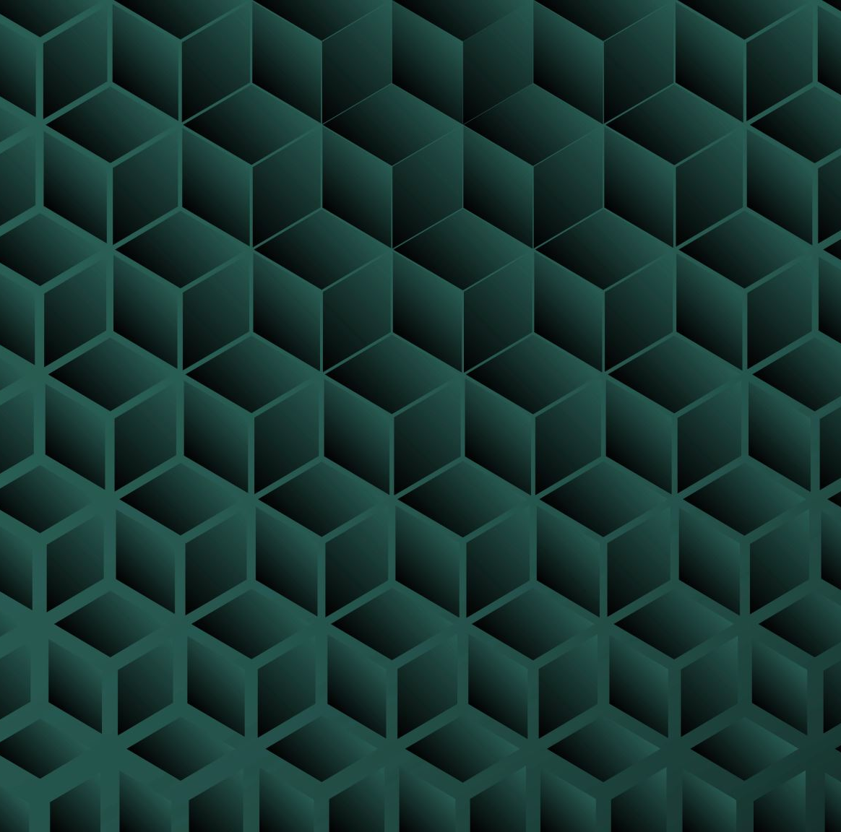
BFS & A* Pathfinding Visualiser
Tony Djikigoue – GAME3540 Final Project

Slide 2
Project Overview
Goal: Create an interactive Unity-based pathfinding visualiser for BFS and A*
Built using: Unity, C#, UI Toolkit, Coroutines
Target: Demonstrate real-time wavefront expansion and shortest pathfinding.

Slide 3

Key Features
Selectable Start & End points
BFS and A* search algorithms
Adjustable grid size (via sliders)
Adjustable search delays (wave & path)
Agent animation on completion
Clean, polished UI with interactivity

Slide 4
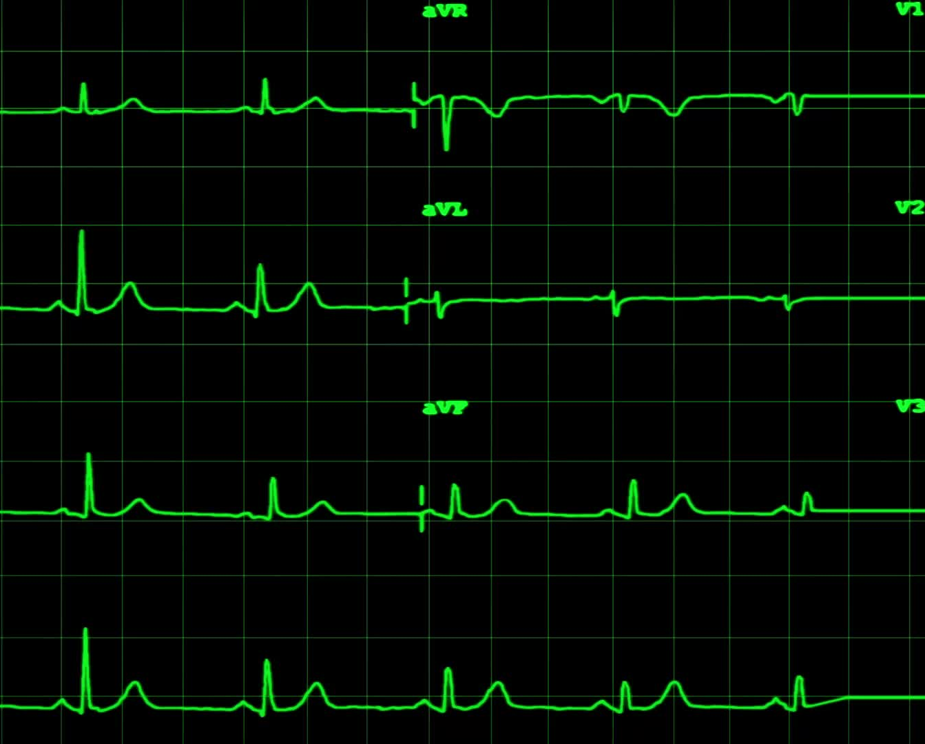
Testing & Validation
Smoke tests:
Empty grid ✔️
Full-block grid ✔️
Adjacent start/end ✔️
Performance:
50x50 grid handled smoothly
Testing report & profiling documented

Slide 5
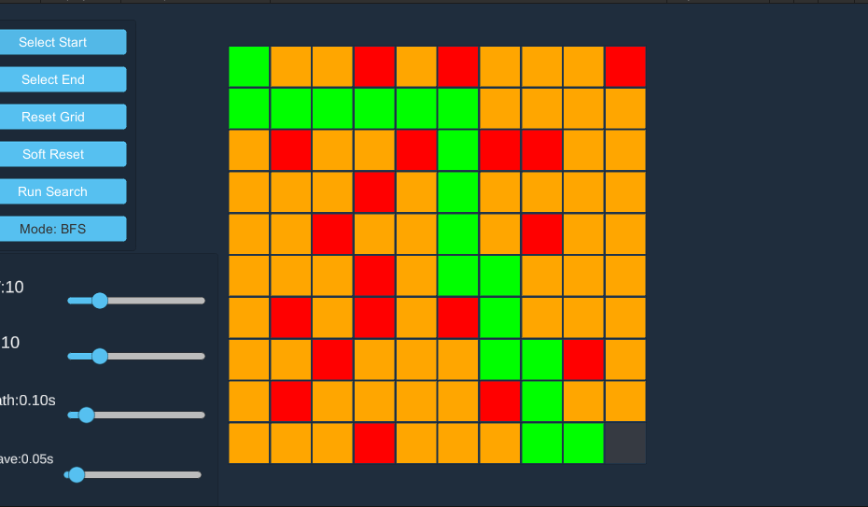
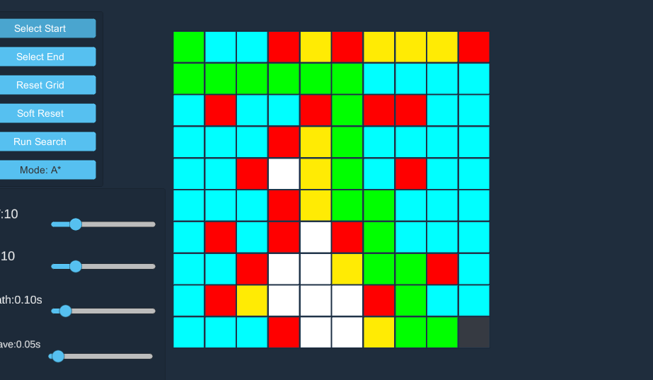
Demo Walkthrough
Select
Select Start & End
Create
Create the walls by clicking on empty tiles
Run
Run BFS → Soft Reset → Run A*
Adjust
Adjust delays and grid size live

Slide 6
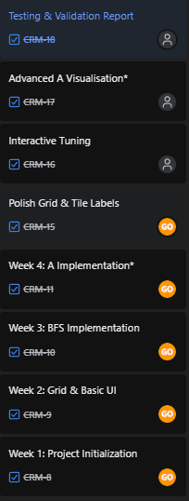
Development Process
Week 1–2: Planning & algorithm structure
Week 3–4: Grid system & UI
Week 5+: Visualisation, polish & testing
Jira board used for tracking

Slide 7
Reflection & Lessons
Strong understanding of BFS/A* implementation
Improved Unity UI layout skills
Learned to break down complex behaviours into manageable tasks
Key takeaway: importance of test-driven debugging

Slide 8
What’s Next?
Potential improvements:
Diagonal pathfinding
Weighted tile costs
Exportable data/profiles
Your turn: https://github.com/OTRtee/AIPathfinding-Showcase.git

